Slide 1
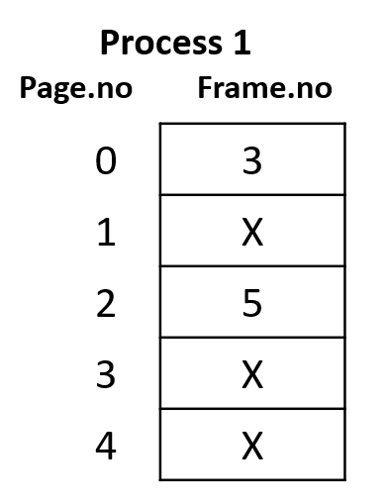
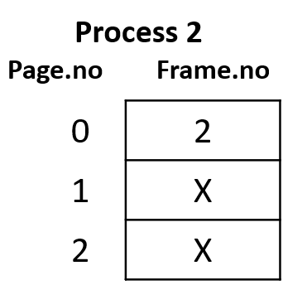
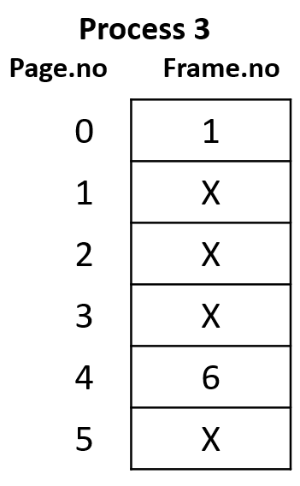
Paging Table
Process 1
Page.no Frame.no
0 | 3
1 | X
2 | 5
3 | X
4 | X
Memory

Slide 2
Inverted Page Table
Inverted Page Table
Frame.no | Page.no | ProcessID
0 | X | X
1 | 0 | P3
2 | 0 | P2
3 | 0 | P1
4 | X | X
5 | 3 | P1
6 | 4 | P3
Memory

